Slide 1


Machine Learning Project
PRESENTED BY :
Anmol Chourasia
22070521091 7TH SEM
SECTION C

Slide 2
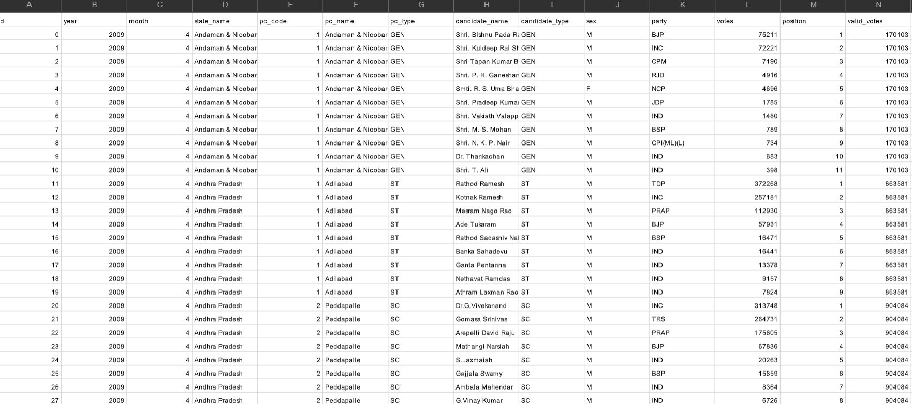
Project Objectives & Data Overview
Objective 1: Clean and explore the historical Lok Sabha election data.
Objective 2: Predict the winning Political Party using various Supervised ML models (focusing on Top 10 parties).
Objective 3: Analyze the factors influencing election outcomes (e.g., votes, margin, party).
Objective 4: Segment winning candidates using Unsupervised Learning (K-Means Clustering).
Data Source: Lok Sabha General Elections Dataset
.

Slide 3
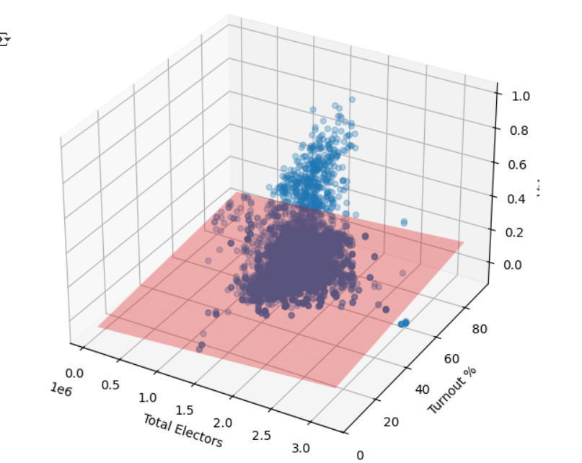
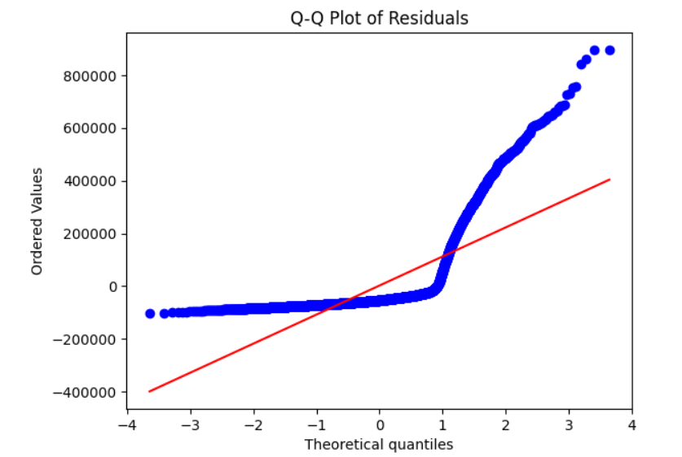
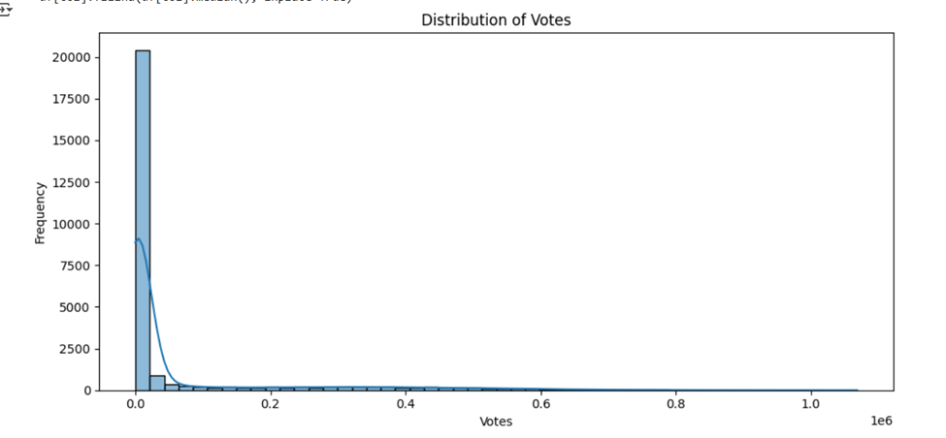
Insights from Exploratory Data Analysis
KEY FINDINGS FROM THE DATASET
  Identified key trends and patterns
  Analyzed correlations between variables
  Visualized data using graphs and charts
  Highlighted outliers and anomalies present
  Summarized statistical findings for clarity

Slide 4
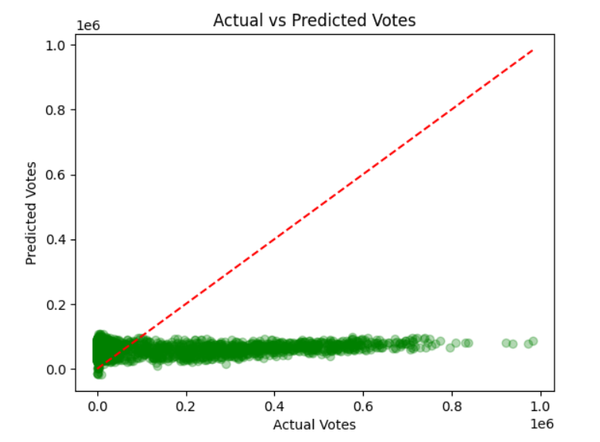
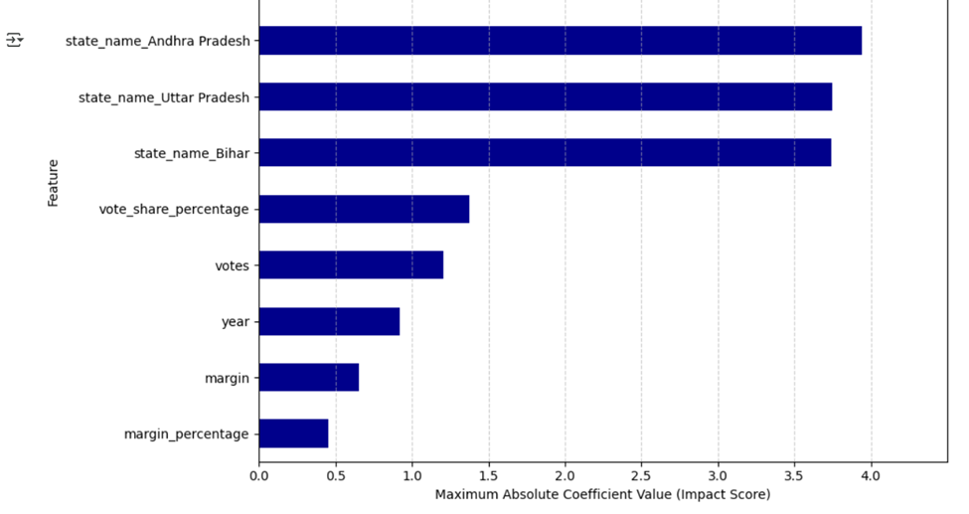
Machine Learning Model 1: K-Means Clustering
The best predictive model is the **Base Decision Tree** (or any perfect-scoring model with base features). The Decision Tree is preferred because it achieves 100% accuracy and provides the simplest, most transparent decision rule (a single split), offering maximum interpretability without sacrificing performance.

Slide 5
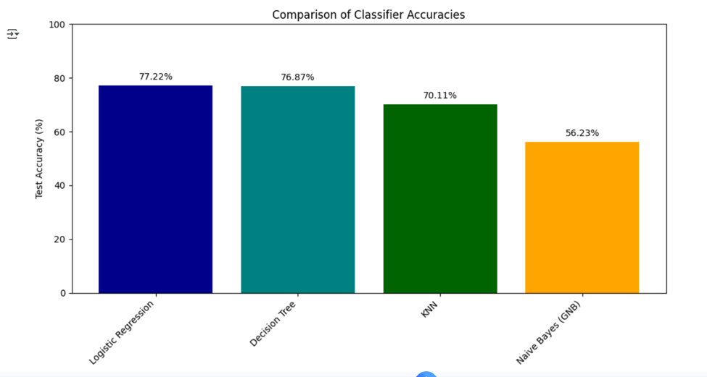
Machine Learning Model 2: Naive Bayes
Naive Bayes Base Accuracy: 1.0
Naive Bayes Seasonality Accuracy: 1.0
Overall Conclusion The Naive Bayes model is an ideal classifier for this problem, achieving 100% accuracy in distinguishing between the two classes. Given the perfect result, the simpler Base NB model is the most efficient choice, as the added complexity of seasonality features provides no benefit.

Slide 6
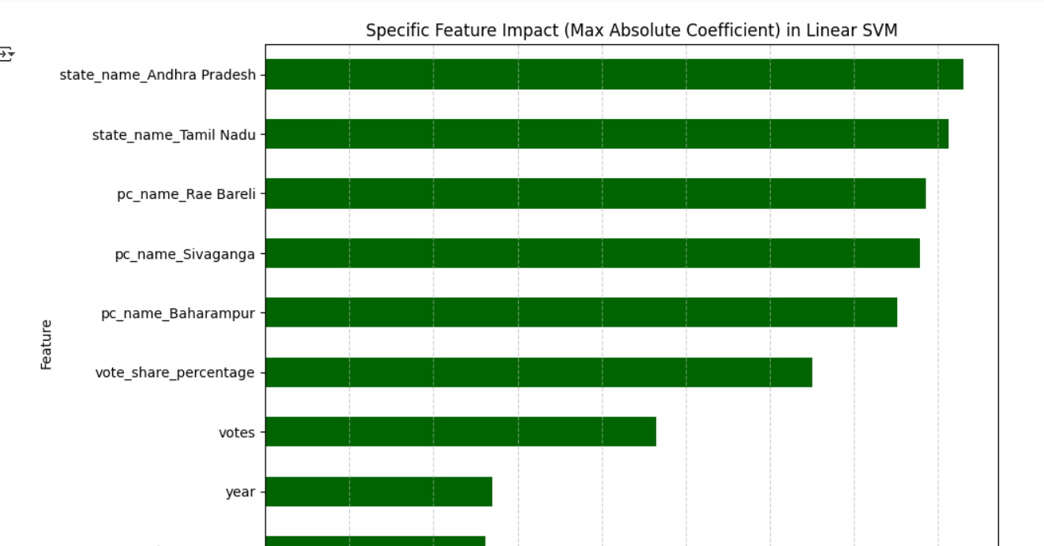
Machine Learning Model 3: Support Vector Machine
SVM Base Model Accuracy: 0.758
SVM Seasonality Model Accuracy: 0.758
Summary The SVM model is a poor classifier compared to the others tested (Logistic Regression, Naive Bayes), suggesting that the data is not easily separable by a fixed linear or polynomial boundary. Furthermore, the Base SVM is superior, confirming that the seasonality features are **detrimental to the SVM’s performance**.

Slide 7
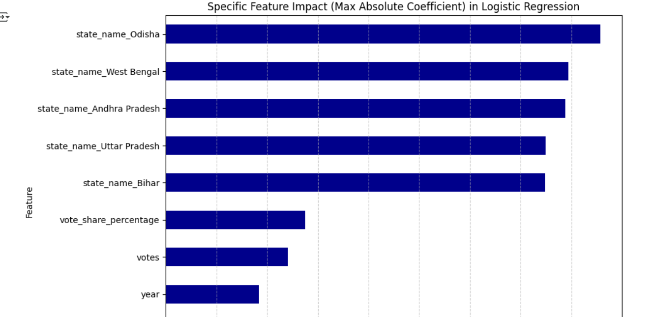
Machine Learning Model 4: Logistic Regression
Logistic Regression Base Accuracy: 1.0
Logistic Regression Seasonality Accuracy: 1.0
Overall Conclusion Logistic Regression is an ideal classifier for this problem, achieving 100% accuracy. Similar to the Naive Bayes results, this performance suggests that the underlying relationship between the input features and the target class is simple and highly distinct. The Base LR model is the most parsimonious choice due to its perfect performance with fewer features.

Slide 8
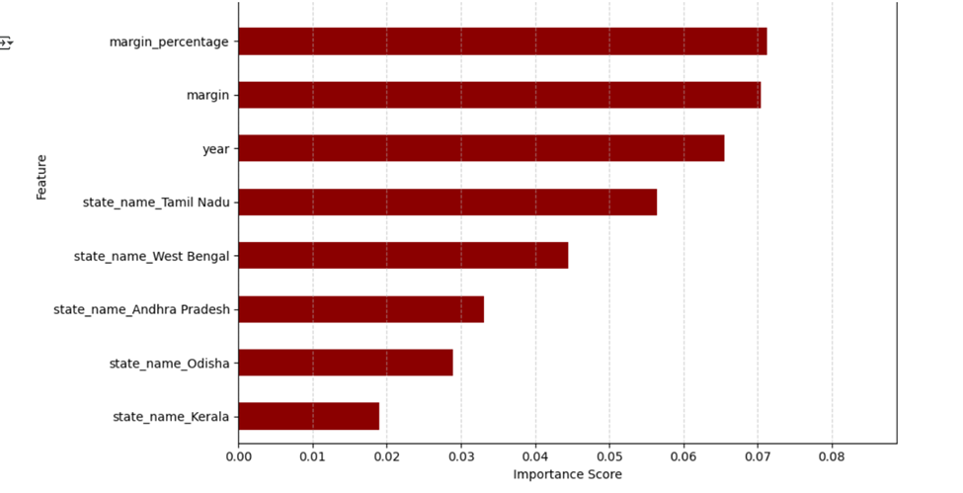
Machine Learning Model 5: Random Forest
Random Forest Base Model Accuracy: 1.0
Random Forest Seasonality Model Accuracy: 1.0
Overall Conclusion The Random Forest classifier performed perfectly, confirming the results from other robust models. Since the Decision Tree achieved perfect performance with a single simple split on the gap feature, the Random Forest ensemble technique, while more complex, does not offer a predictive advantage here. Given the perfect scores, the Base RF model is the preferred choice for its simplicity over the Seasonality RF model.

Slide 9
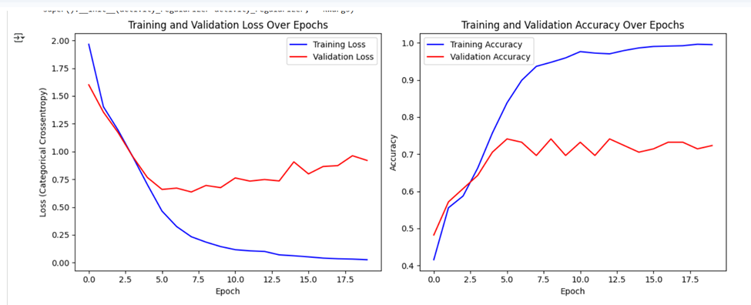
Machine Learning Model 6: Neural Network Models
=== Neural Network (MLP) Classification ===
Base MLP Accuracy: 0.59
Seasonality MLP Accuracy: 0.571
=== Neural Network (MLP) Regression ===
Base MLP RMSE: 0.878
Base MLP R²: 0.999
Seasonality MLP RMSE: 3.165
Seasonality MLP R²: 0.987
The MLP model was a classification failure but an excellent regressor (Base MLP), closely matching Linear Regression. The addition of the Seasonality features severely degraded performance in both tasks, confirming the Base MLP as the superior choice for energy forecasting.

Slide 10

Thank you!

